Slide 1



HACK MATRIX HACKATHON
PROJECT TITLE : Peer Support Connector
TEAM NAME : Code Catalysts
TEAM MEMBERS : Aaditi Shrivastava ( 25BCY10019 )
Diya Payal ( 25BAI10593 )
Aniket Sahu ( 25BAI11514 )
Varad Prabhu ( 25BAI10425 )

Slide 2

PROBLEM STATEMENT
Describe the problem clearly :
Students today face increasing levels of stress, anxiety, and emotional challenges due to academic pressure, social expectations, and lifestyle changes. Despite this, many students do not seek help due to fear of judgment, lack of trust, and uncomfortable onboarding processes . Existing mental health platforms are often reactive, expensive, or impersonal, failing to provide instant low-pressure, and personalized support. There is a lack of systems that offer anonymous, proactive, and emotionally intelligent support at the early stage of distress.
Who is affected by this problem:
College and university students . Students dealing with academic pressure, loneliness, or emotional stress
Why this problem is important ?
Many students avoid seeking help, leading to worsening mental health. Early support can prevent serious issues and improve well-being.

Slide 3
EXISTING SOLUTIONS AND GAPS
List of existing Solutions :
Platforms like 7 Cups and Wysa provide peer support and AI-based emotional assistance. These systems enable users to chat anonymously or interact with AI/chat communities
Mention their Limitations:
Mostly reactive – users must initiate help. Basic AI – limited emotional understanding .Unstructured support – no quick, guided sessions . Weak matching – not personalized .Limited real-time crisis detection
Explain the gap your project will address:
Our project reduces hesitation by providing proactive, anonymous, and structured emotional support with intelligent matching and real-time safety.

Slide 4
PROPOSED SOLUTION
Explain your solution clearly : We propose an AI-assisted, anonymous peer support platform that enables students to access emotional support instantly without hesitation.The system is designed to reduce psychological barriers by removing login, identity requirements, and complex interactions.It combines human empathy (peer support) with AI-driven intelligence to provide safe, accessible, and personalized support.
List key features : No login, anonymous access, Humanized AI + proactive detection, Smart matching + micro sessions Real-time crisis support
Explain how it solves the problem :
Reduces hesitation with frictionless entry, Provides proactive and personalized support, Ensures safe and timely intervention

Slide 5
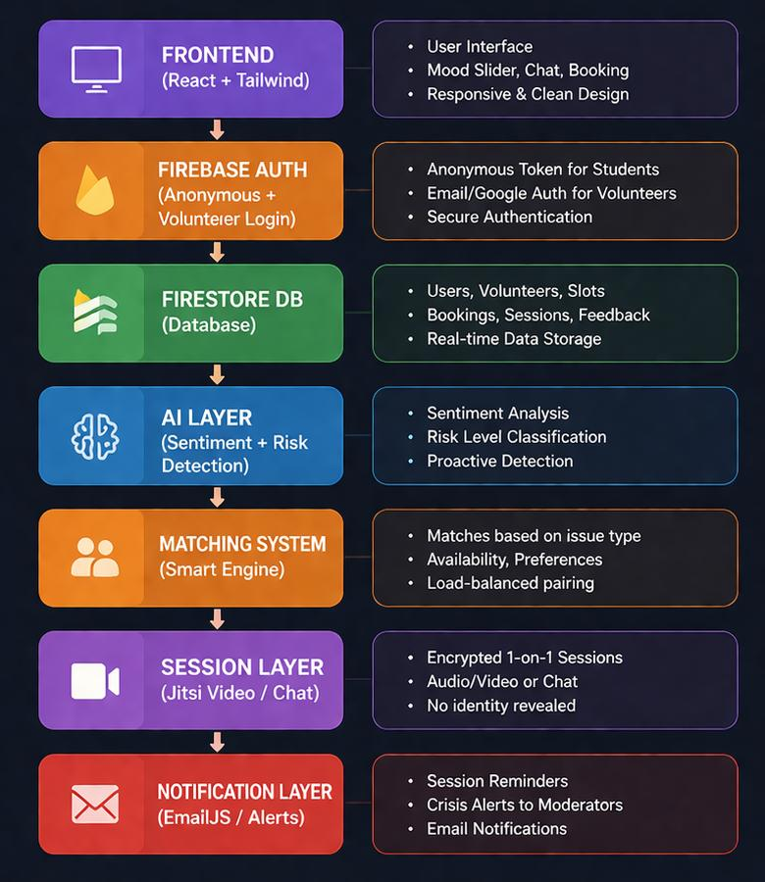
SYSTEM ARCHITECTURE

Slide 6
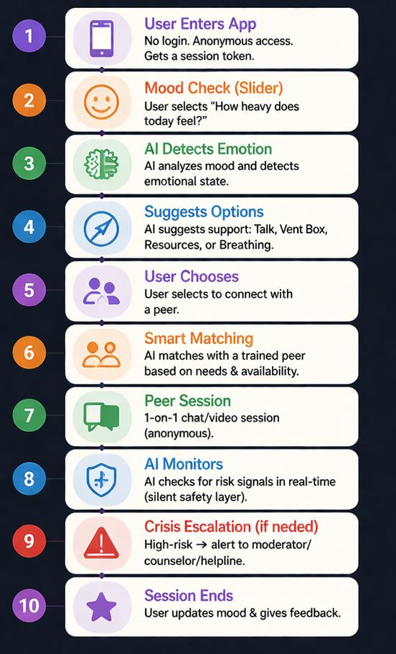
WORKING PROCESS

Slide 7
TECH STACK
Frontend technologies : React.js + Tailwind CSS → Fast, responsive, and clean UI
Backend technologies : Firebase Authentication → Secure anonymous + volunteer loginNode.js (optional logic layer) → Handles matching & AI integration
Database : Cloud Firestore → Real-time, scalable data storage
Tools & APIs (with reason) : OpenAI API / NLP models → Sentiment analysis & emotion detectionJitsi Meet API → Secure video/audio peer sessionsEmailJS / Firebase Notifications → Alerts & crisis escalationFirebase Hosting → Easy deployment & scalability

Slide 8
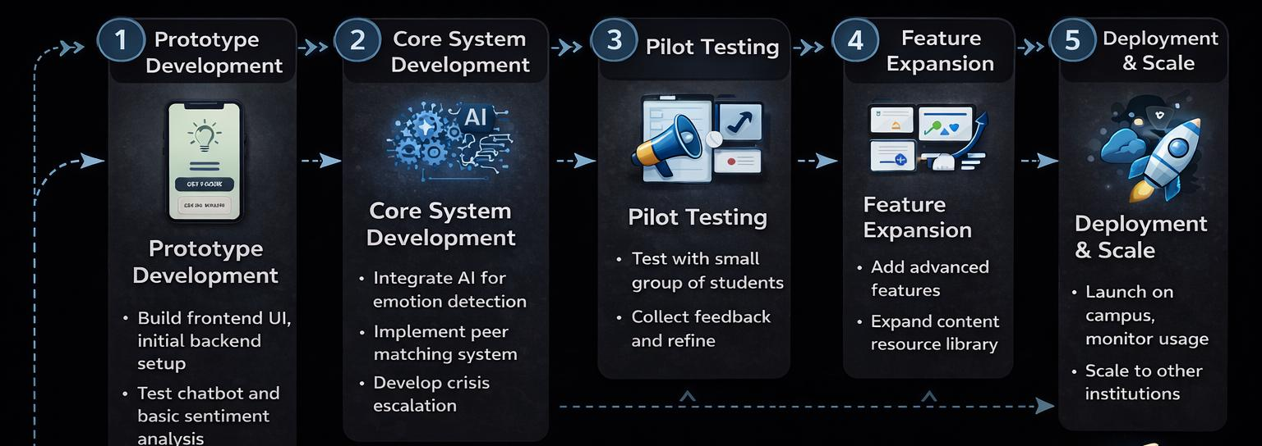
IMPLEMENTATION PLAN

Slide 9
EXPECTED OUTCOME / IMPACT
Expected results of the project : Increased student engagement in mental health support. Faster access to early-stage emotional assistance. Improved effectiveness of peer support systems
Benefits to users : Safe and anonymous environment to express feelingsLow-pressure, instant support. Personalized and emotion-aware interaction.
Real-world impact : Reduces mental health stigma in campuses. Prevents escalation of serious emotional issuesScalable solution for colleges and institutions.

Slide 10
FUTURE SCOPE AND CONCLUSION
Future improvements : Advanced AI models for deeper emotional understanding. Integration with professional therapists & helplines. Mobile app development for wider accessibility.
Final summary : We built a system that reduces hesitation in seeking help. Combines AI + peer support for effective emotional assistance. Focuses on anonymity, safety, and user comfort.
Scalability of the project : Can be implemented across colleges and universities. Easily scalable using cloud-based architecture. Potential to expand into corporate and public mental health systems.

